Slide 1



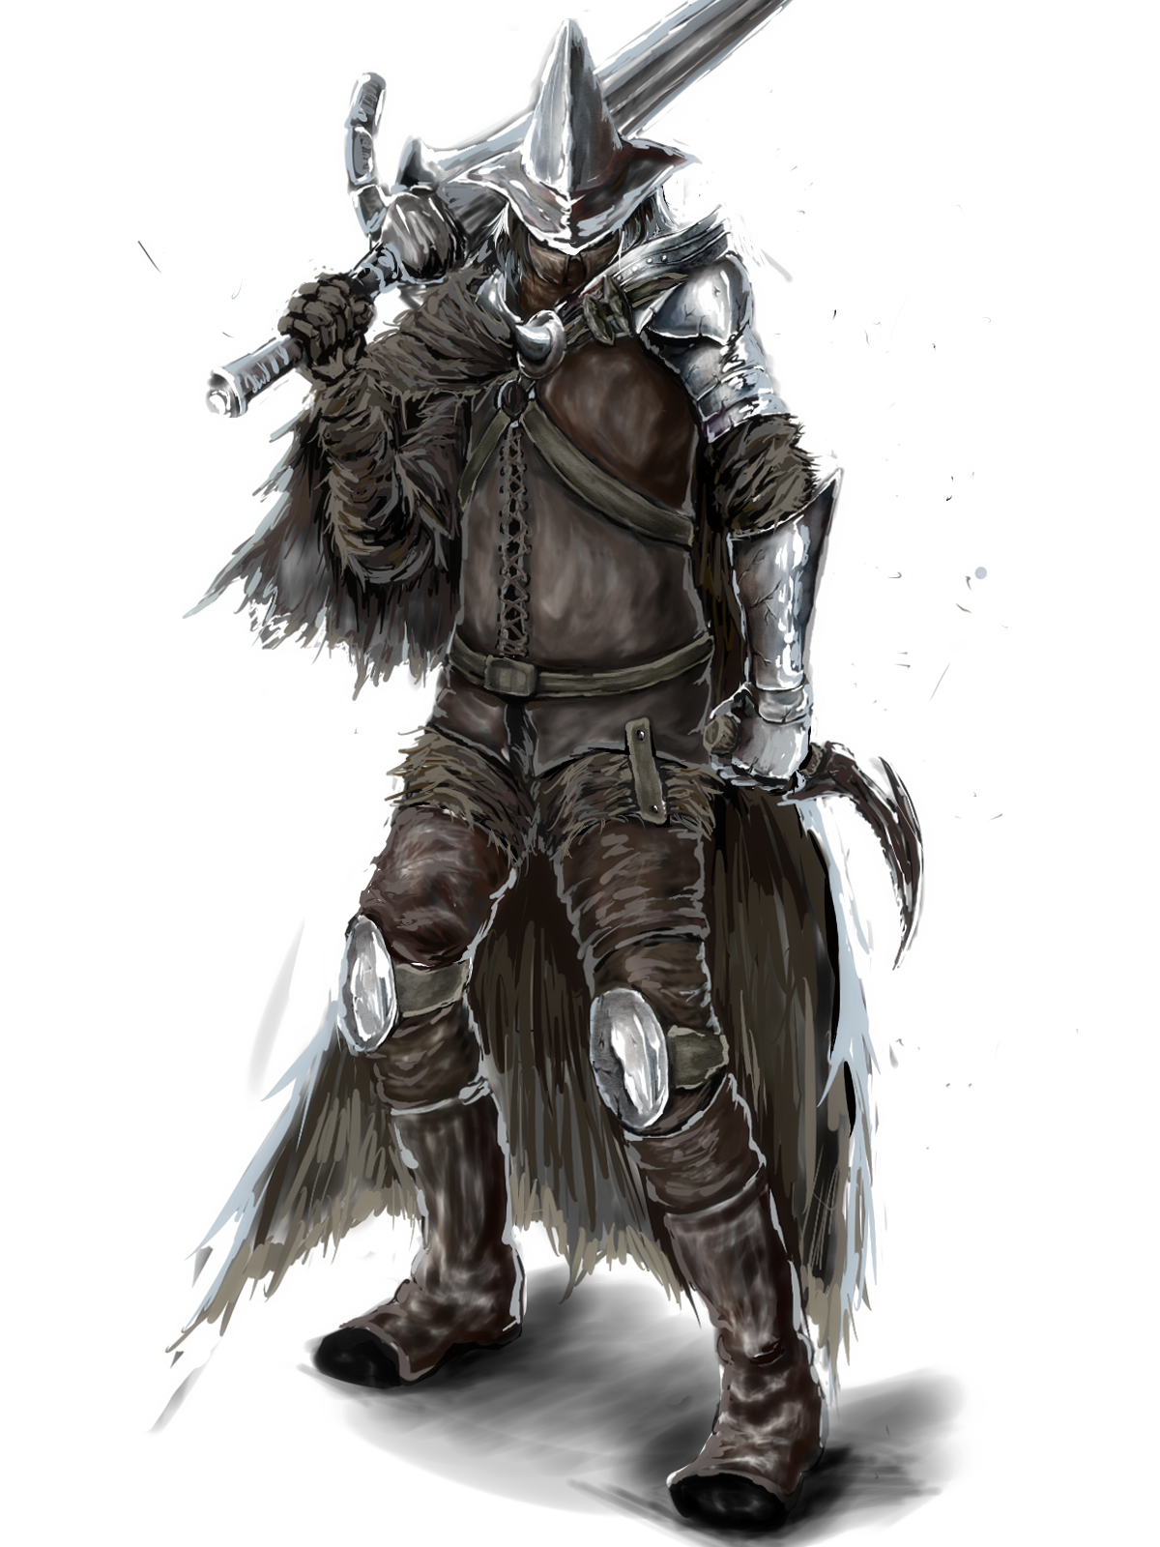
OOP Project 1st stage

Slide 2

Hero Type
Wizard
Pyromancer
Knight
Rogue

Slide 3




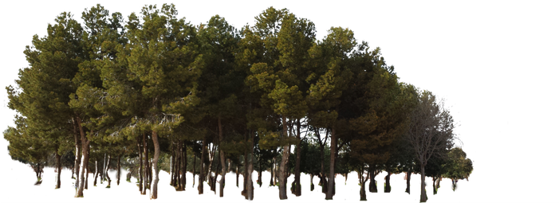
Map Type
Desert (Wizard)
Volcano (Pyromancer)
Land (Knight)
Woods (Rogue)

Slide 4
Wizard
HP: 400 initial, +30/level
10% bonus on Desert
Abilities
Drain
percent: 20%, +5%/level
damage = percent * min(0.3 * OPPONENT_MAX_HP, OPPONENT_CURRENT_HP)
Rogue -20%, Knight +20%, Pyromancer -10%, Wizard +5%
Deflect (no effect on wizards)
percent: 35%, +2%/level, up to 70%
Rogue +20%, Knight +40%, Pyromancer +30%

Slide 5
Pyromancer
HP: 500 initial, +50/level
25% bonus on Volcanic
Abilities
Fireblast
Damage: 350, +50/level
Rogue -20%, Knight +20%, Pyromancer -10%, Wizard +5%
Ignite (damage now and over next 2 rounds)
base damage: 150, +20/level
50 damage/round, +30/level
Rogue -20%, Knight +20%, Pyromancer -10%, Wizard +5%

Slide 6
Knight
HP: 900 initial, +80/level
15% bonus on Land
Abilities
Execute
base damage:200, +30/level
HP limit 20% * opponent’s max HP at current level
+1%/level, up to 40%
Rogue +15%, Knight +0%, Pyromancer +10%, Wizard -20%
Slam (stun)
base damage: 100 base damage. +40 /level
Rogue -20%, Knight +20%, Pyromancer -10%, Wizard +5%

Slide 7
Rogue
HP : 600 initial, +40 /level
15% bonus on Woods
Abilities
Backstab
base damage: 200, +20 dmg /level
once at three hits has 1.5*damage if on Woods
Rogue +20%, Knight -10%, Pyromancer +25%, Wizard +25%
Paralysis
damage/round: 40, +10/level
no. rounds 3 (6 if on Woods when hit)

Slide 8
Example 3x3
Input: Output
3 3 R 4 400 760 0 1
WWW W dead
WWW W dead
WWW W 0 0 300 1 1
4
R 0 0
W 0 2
W 1 0
W 1 2
5
RLRL
____
____
____
__U_

Slide 9
Initial State
WOODS Rogue | WOODS | WOODS Wizard0
WOODS Wizard1 | WOODS | WOODS Wizard2
WOODS | WOODS | WOODS
HP Level XP
Rogue 600 0 0
Wizard0 400 0 0
Wizard1 400 0 0
Wizard2 400 0 0

Slide 10
First Round (input ”RLRL”)
WOODS Rogue | WOODS | WOODS Wizard0
WOODS Wizard1 | WOODS | WOODS Wizard2
WOODS | WOODS | WOODS

Slide 11
First Round (input ”RLRL”)
WOODS | WOODS Rogue + Wizard0 | WOODS
WOODS | WOODS Wizard1 + Wizard2 | WOODS
WOODS | WOODS | WOODS
Fights
Rogue vs Wizard0
Rogue
Backstab (first hit is critical)
(base_damage*critical*land_bonus)*modifier =
round(round(200*1.5*1.15)*1.25) = 431
Paralysis
(base_damage*land_bonus)*modifier =
round(round(40*1.15)*1.25) = 58
6 rounds paralysis
Total damage: 489
Total without modifiers = 345 + 46 = 391

Slide 12
First Round (input ”RLRL”)
WOODS | WOODS Rogue + Wizard0 | WOODS
WOODS | WOODS Wizard1 + Wizard2 | WOODS
WOODS | WOODS | WOODS
Fights
Rogue vs Wizard0
Wizard0
Drain
(percent * min(0.3 * OPPONENT_MAX_HP, OPPONENT_CURRENT_HP)) =
round((20% -(20% of 20%))*(0.3*600)) =
round((20% - 4%)*180) =
round(16%*180) = 29
Deflect
percent * damage_taken_without_modifiers =
round((35%*391)*1.2) = 164
Total damage: 193

Slide 13
First Round (input ”RLRL”)
WOODS | WOODS Rogue + Wizard0 | WOODS
WOODS | WOODS Wizard1 + Wizard2 | WOODS
WOODS | WOODS | WOODS
Fights
Wizard1 vs Wizard2
Wizard1
Drain
(percent * min(0.3 * OPPONENT_MAX_HP, OPPONENT_CURRENT_HP)) =
round((20% +(5% of 20%))*(0.3*400)) =
round((20% + 1%)*120) =
round(21%*120) = 25
Deflect
0
Total damage: 25

Slide 14
First Round (input ”RLRL”)
WOODS | WOODS Rogue + Wizard0 | WOODS
WOODS | WOODS Wizard1 + Wizard2 | WOODS
WOODS | WOODS | WOODS
Fights
Wizard1 vs Wizard2
Wizard2
Drain
(percent * min(0.3 * OPPONENT_MAX_HP, OPPONENT_CURRENT_HP)) =
round((20% +(5% of 20%))*(0.3*400)) =
round((20% + 1%)*120) =
round(21%*120) = 25
Deflect
0
Total damage: 25

Slide 15
After First Round
WOODS | WOODS Rogue | WOODS
WOODS | WOODS Wizard1 + Wizard2 | WOODS
WOODS | WOODS | WOODS
HP Level XP
Rogue 407 0 200
Wizard0 DEAD 0 0
Wizard1 375 0 0
Wizard2 375 0 0

Slide 16
Second Round (input ”____”)
WOODS | WOODS Rogue | WOODS
WOODS | WOODS Wizard1 + Wizard2 | WOODS
WOODS | WOODS | WOODS
Fights
Wizard1 vs Wizard2
Wizard1
Drain
(percent * min(0.3 * OPPONENT_MAX_HP, OPPONENT_CURRENT_HP)) =
round((20% +(5% of 20%))*(0.3*400)) =
round((20% + 1%)*120) =
round(21%*120) = 25
Deflect
0
Total damage: 25

Slide 17
Second Round (input ”____”)
WOODS | WOODS Rogue | WOODS
WOODS | WOODS Wizard1 + Wizard2 | WOODS
WOODS | WOODS | WOODS
Fights
Wizard1 vs Wizard2
Wizard2
Drain
(percent * min(0.3 * OPPONENT_MAX_HP, OPPONENT_CURRENT_HP)) =
round((20% +(5% of 20%))*(0.3*400)) =
round((20% + 1%)*120) =
round(21%*120) = 25
Deflect
0
Total damage: 25

Slide 18
After Second Round
WOODS | WOODS Rogue | WOODS
WOODS | WOODS Wizard1 + Wizard2 | WOODS
WOODS | WOODS | WOODS
HP Level XP
Rogue 407 0 200
Wizard0 DEAD 0 0
Wizard1 350 0 0
Wizard2 350 0 0

Slide 19
Third Round (input ”____”)
WOODS | WOODS Rogue | WOODS
WOODS | WOODS Wizard1 + Wizard2 | WOODS
WOODS | WOODS | WOODS
Fights
Wizard1 vs Wizard2
Wizard1
Drain
(percent * min(0.3 * OPPONENT_MAX_HP, OPPONENT_CURRENT_HP)) =
round((20% +(5% of 20%))*(0.3*400)) =
round((20% + 1%)*120) =
round(21%*120) = 25
Deflect
0
Total damage: 25

Slide 20
Third Round (input ”____”)
WOODS | WOODS Rogue | WOODS
WOODS | WOODS Wizard1 + Wizard2 | WOODS
WOODS | WOODS | WOODS
Fights
Wizard1 vs Wizard2
Wizard2
Drain
(percent * min(0.3 * OPPONENT_MAX_HP, OPPONENT_CURRENT_HP)) =
round((20% +(5% of 20%))*(0.3*400)) =
round((20% + 1%)*120) =
round(21%*120) = 25
Deflect
0
Total damage: 25

Slide 21
After Third Round
WOODS | WOODS Rogue | WOODS
WOODS | WOODS Wizard1 + Wizard2 | WOODS
WOODS | WOODS | WOODS
HP Level XP
Rogue 407 0 200
Wizard0 DEAD 0 0
Wizard1 325 0 0
Wizard2 325 0 0

Slide 22
Fourth Round (input ”____”)
WOODS | WOODS Rogue | WOODS
WOODS | WOODS Wizard1 + Wizard2 | WOODS
WOODS | WOODS | WOODS
Fights
Wizard1 vs Wizard2
Wizard1
Drain
(percent * min(0.3 * OPPONENT_MAX_HP, OPPONENT_CURRENT_HP)) =
round((20% +(5% of 20%))*(0.3*400)) =
round((20% + 1%)*120) =
round(21%*120) = 25
Deflect
0
Total damage: 25

Slide 23
Fourth Round (input ”____”)
WOODS | WOODS Rogue | WOODS
WOODS | WOODS Wizard1 + Wizard2 | WOODS
WOODS | WOODS | WOODS
Fights
Wizard1 vs Wizard2
Wizard2
Drain
(percent * min(0.3 * OPPONENT_MAX_HP, OPPONENT_CURRENT_HP)) =
round((20% +(5% of 20%))*(0.3*400)) =
round((20% + 1%)*120) =
round(21%*120) = 25
Deflect
0
Total damage: 25

Slide 24
After Fourth Round
WOODS | WOODS Rogue | WOODS
WOODS | WOODS Wizard1 + Wizard2 | WOODS
WOODS | WOODS | WOODS
HP Level XP
Rogue 407 0 200
Wizard0 DEAD 0 0
Wizard1 300 0 0
Wizard2 300 0 0

Slide 25
Fifth Round (input ”__U_”)
WOODS | WOODS Rogue | WOODS
WOODS | WOODS Wizard1 + Wizard2 | WOODS
WOODS | WOODS | WOODS

Slide 26
Fifth Round (input ”__U_”)
WOODS | WOODS Rogue + Wizard1 | WOODS
WOODS | WOODS Wizard2 | WOODS
WOODS | WOODS | WOODS
Fights
Rogue vs Wizard1
Rogue
Backstab (second hit is not critical)
(base_damage*critical*land_bonus)*modifier =
round(round(200*1*1.15)*1.25) = 288
Paralysis
(base_damage*land_bonus)*modifier =
round(round(40*1.15)*1.25) = 58
6 rounds paralysis
Total damage: 346
Total without modifiers = 230 + 46 = 276

Slide 27
Fifth Round (input ”__U_”)
WOODS | WOODS Rogue + Wizard1 | WOODS
WOODS | WOODS Wizard2 | WOODS
WOODS | WOODS | WOODS
Fights
Rogue vs Wizard1
Wizard1
Drain
(percent * min(0.3 * OPPONENT_MAX_HP, OPPONENT_CURRENT_HP)) =
round((20% -(20% of 20%))*(0.3*600)) =
round((20% - 4%)*180) =
round(16%*180) = 29
Deflect
percent * damage_taken =
round((35%*276)*1.2) = 116
Total damage: 145

Slide 28
After Fifth Round
WOODS | WOODS Rogue | WOODS
WOODS | WOODS Wizard2 | WOODS
WOODS | WOODS | WOODS
HP Level XP
Rogue 760 4 400
Wizard0 DEAD 0 0
Wizard1 DEAD 0 0
Wizard2 300 0 0
Rogue will have 200 + 200 XP, and the level up system is: 200 + 50/level
=> 400XP = 200 + 4 * 50 => Rogue becomes level 4.

Slide 29
So the output will be:
R 4 400 760 0 1
W dead
W dead
W 0 0 300 1 1

